Slide 1



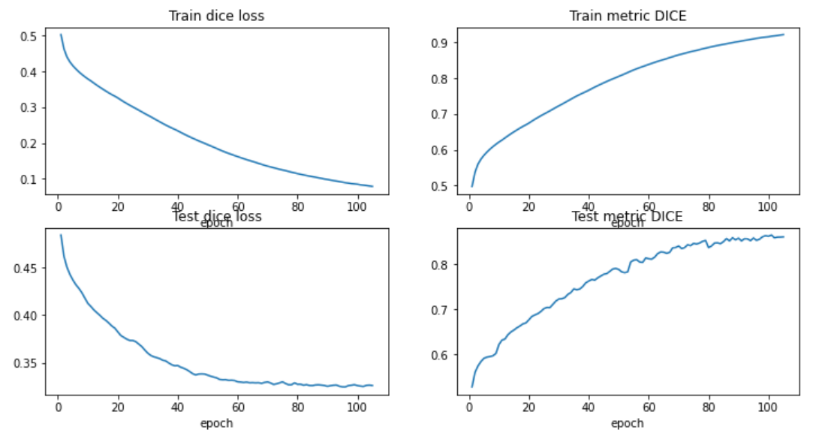
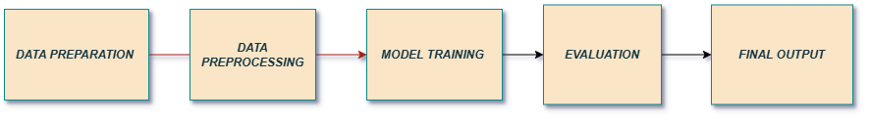
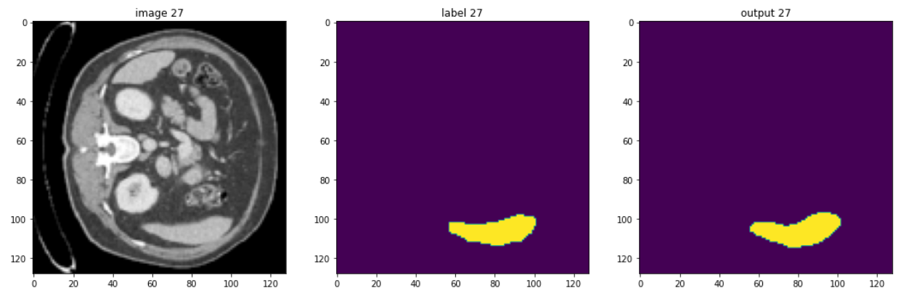
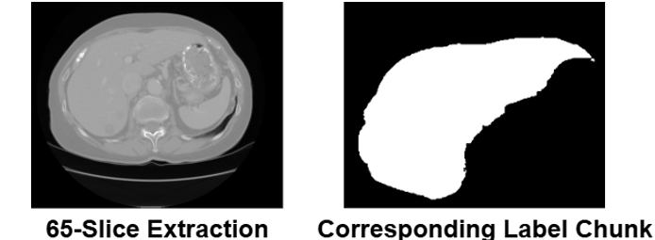
Automated Liver Segmentation in Medical Imaging for Enhanced Diagnostic Accuracy
Aniket Kumar (23MDT1007)
M.Sc. Data Science
Department of Mathematics
School of Advanced Sciences
Vellore Institute of Technology, Chennai
Dr. A David Maxim Gururaj
Associate Professor
Department of Mathematics
School of Advanced Sciences
Vellore Institute of Technology, Chennai
Motivation/ Introduction
Results
Accurate liver segmentation plays a critical role in computer-aided diagnosis, surgical planning, and treatment monitoring of liver diseases. Manual segmentation is time-consuming, subject to inter-observer variability, and requires expert knowledge. To overcome these limitations, this project presents a deep learning-based approach using a 3D U-Net architecture implemented with the MONAI framework and PyTorch. The model is trained on volumetric CT scans to automatically identify and segment liver regions, aiming to enhance both precision and efficiency in medical image analysis.
Scope of the Project
The performance of the proposed 3D U-Net model for liver segmentation was evaluated using Dice Loss and Dice Coefficient metrics. These metrics were chosen for their effectiveness in assessing pixel-wise similarity between predicted and ground truth segmentation masks. Dice Loss measures the discrepancy, where lower values indicate better performance, while the Dice Coefficient evaluates overlap, with values closer to 1 indicating higher accuracy. During training over 100 epochs, the model demonstrated steady improvement. The training Dice Loss decreased from 0.5 to 0.09, while the Dice Coefficient improved from 0.5 to 0.9, indicating accurate mask prediction. Testing results followed a similar trend, with the test Dice Loss decreasing from 0.47 to 0.32, and the Dice Coefficient rising from 0.5 to 0.85, showcasing strong generalization to unseen data. The final segmentation accuracy reached 95.94%.
The model outperformed traditional methods, which usually achieve Dice scores of 0.75–0.80, with a 6–10% improvement. These findings confirm effective learning without overfitting, fulfilling the project’s objective of enhancing liver segmentation performance.
The project focuses on automating liver segmentation from 3D CT scans using deep learning with MONAI and PyTorch. It aims to reduce manual effort in medical image analysis while improving speed, consistency, and accuracy. The solution supports radiologists in diagnosis and is adaptable for large-scale clinical use, aiding advancements in computer-aided diagnosis and treatment planning.
Methodology
The project follows a structured methodology for automated liver segmentation from 3D CT scan volumes. The dataset comprises volumetric medical images and their corresponding ground truth segmentation masks, organized into separate folders for training and testing. In the preparation phase, the images and labels are matched and verified. The preprocessing step includes converting the data to a consistent spatial format, resampling all volumes to a common voxel spacing to ensure uniformity, and reorienting the images to a standard anatomical direction (Right-Anterior-Superior). Intensity values are normalized to enhance contrast between liver tissues and the background. Foreground cropping is applied to remove unnecessary background areas, and all volumes are resized to a fixed shape to match the input requirements of the model.
A 3D U-Net architecture is utilized for segmentation. It consists of multiple encoding and decoding blocks that extract hierarchical features from the input and reconstruct spatial details for accurate mask prediction. The encoding path captures contextual information while the decoding path ensures precise localization. The model is trained using volumetric data, where each batch is passed through the network, and the loss is computed by comparing the predicted output with the actual segmentation. Dice Loss is used to handle class imbalance and promote overlap between predicted and ground truth masks. Optimization is performed using an adaptive algorithm that updates the model parameters based on loss gradients. After training, the model is evaluated on test data using a sliding window approach, and performance is measured through Dice score accuracy.
Conclusion
The liver segmentation model using 3D U-Net and MONAI effectively learned to identify liver regions with consistent improvement in performance during training and testing. The steady drop in Dice Loss and rise in the Dice Coefficient indicate successful learning and good generalization. This approach outperformed traditional methods, proving to be a reliable solution for liver segmentation in medical imaging.
Contact Details
aniket.kumar2023@vitstudent.ac.in davidmaxim.gururaj@vit.ac.in
References
Cardoso, M. J., Li, W., Brown, R., Ma, N., Kerfoot, E., Wang, Y., Murrey, B., Myro nenko, A., Zhao, C., Yang, D., Nath, V., He, Y., Xu, Z., Hatamizadeh, A., Zhu, W., Liu, Y., Zheng, M., Tang, Y., Yang, I., and Feng, A. (2022). Monai: An open-source framework for deep learning in healthcare.
Dice, L. R. (1945). Measures of the amount of ecologic association between species. Ecology, 26(3):297–302.
Gotra, A., Sivakumaran, L., Chartrand, G., Vu, K.-N., Vandenbroucke-Menu, F., Kauff mann, C., Kadoury, S., Gallix, B., de Guise, J., and Tang, A. (2017). Liver segmen tation: indications, techniques and future directions. Insights into imaging, 8.
Islam, M., Khan, K., and Khan, M. S. (2021). Evaluation of preprocessing techniques for u-net based automated liver segmentation.
Jadon, S. (2020). A survey of loss functions for semantic segmentation. pages 1–7.

